Slide 1
Document Embedding for Scientific articles
Validation of word embeddings
Arjan Meijer
Supervisors: R. Karimi, J.A. Schijvenaars & R. Cushing

Slide 2
Word embeddings
Word representation as vector
Captures word relatedness
Wide application:
Search & recommendation
Classification
Notes:
Named entity recognition, part-of-speech tagging, parsing & semantinc role labelling

Slide 3
Validation
Matching articles to journals
Embedding
TF-IDF
Visualization of embeddings
Notes:
Ranking, Rank Distribution & F1-scores
TF-IDF weighted, 10K, 5K, 1-6K
10K_10K, 10K_5K, 5K_5K

Slide 4
Data
All articles published in 2017
1.4M articles
3.8K journals
Word embedding
Article embedding
Journal embedding
Notes:
Ranking, Rank Distribution & F1-scores
TF-IDF weighted, 10K, 5K, 1-6K
10K_10K, 10K_5K, 5K_5K

Slide 5
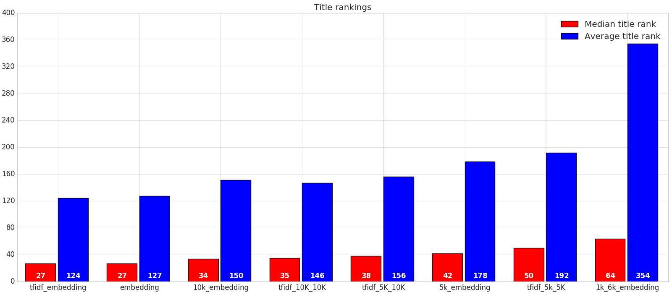
Ranking result title

Slide 6
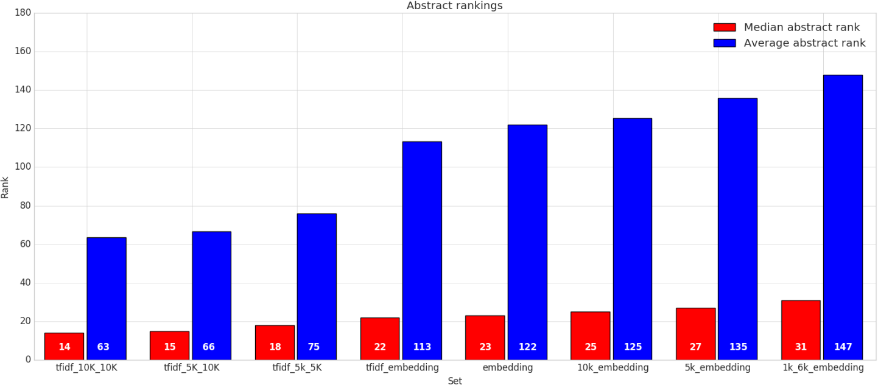
Ranking result abstract

Slide 7
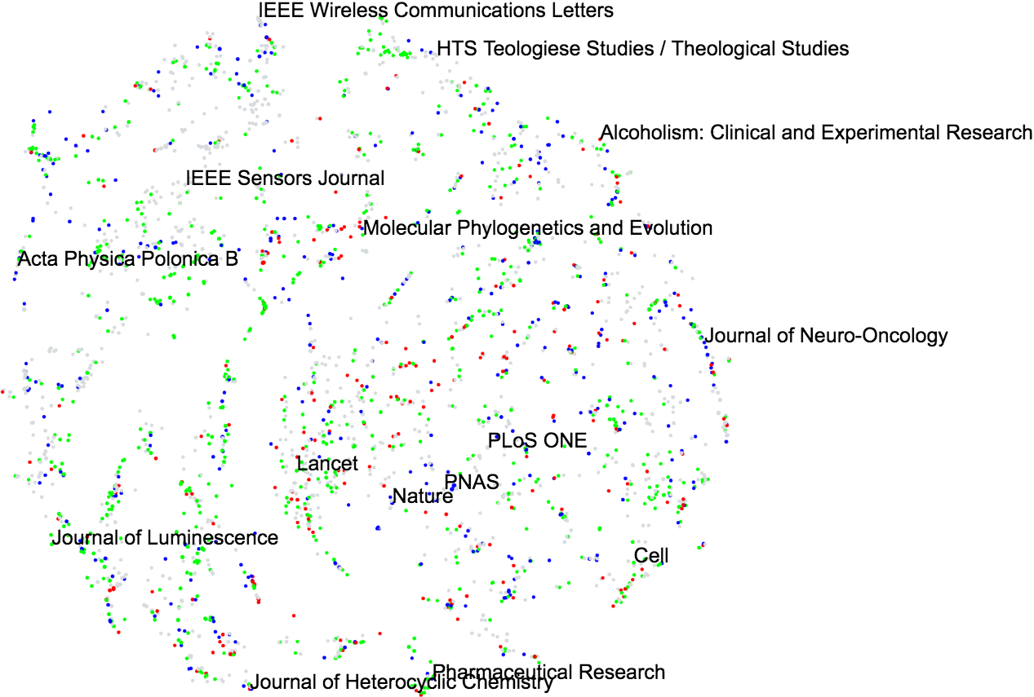
Notes:
LIME: Elsevier
Blue: Springer_Nature
Red: Wiley

Slide 8
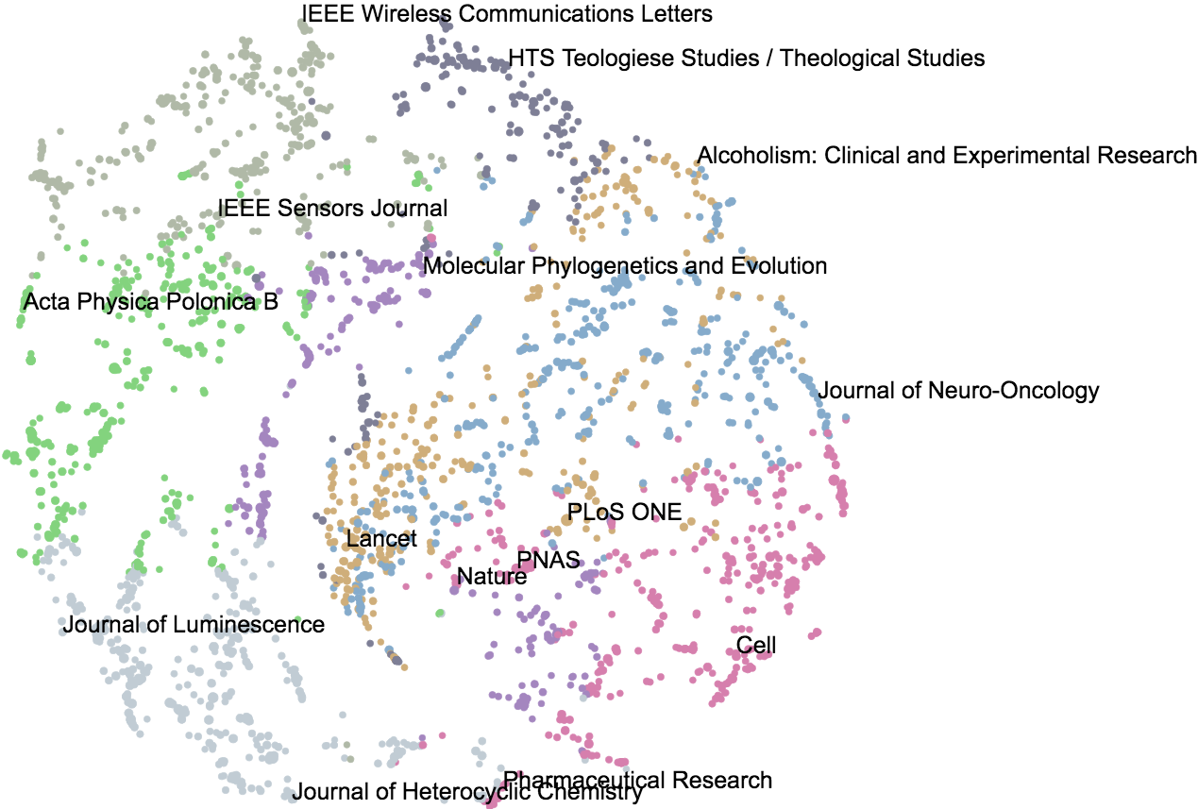

(Social and behavioral sciences)
(Chemical sciences)
(Experimental and clinical medicine)
Notes:
SAGE open: social and behavioral sciences and humanities
RSC Advances: chemical sciences
Orvosi hetilap: experimental and clinical medicine

Slide 9
Conclusions
Embeddings are able to capture the meaning of academic texts
Embeddings perform better than TF-IDF on title
TF-IDF can outperform embeddings on abstract
Visualization of embeddings show relationships of research areas

